Slide 1

Group 10 Ireion, Gabriel, Remi, Ope
40 years of Apple, Inc.’s stock market trends in reference to the Gains & Losses

Slide 2

Content
Why this Topic?
Data Source
Database
Machine Learning
Dashboard
R-Analysis
Conclusion

Slide 3
Description of the communication protocols
X: Gabriel
Technology & R-Analysis
Circle: Remi
Database Integration & R-Analysis
Square: Ope
GitHub Repository & Dashboard
Triangle: Iry
Machine Learning & Powerpoint

Slide 4
Selected Topic
As it relates to human behavior, how do seasons, fiscal quarters, months, and even years compare in gains and losses, for Apple, Inc (APPL) stock?

Slide 5
Why this Topic?
We wish to predict the greatest opportunity for gains and avoid the greatest pitfalls for losses as one considers investing in Apple’s stock

Slide 6

Data Source
The dataset utilized is from Kaggle.com, titled the “NYSE”.
Link: https://www.kaggle.com/varpit94/apple-stock-data-updated-till-22jun2021
This dataset begins on Apple’s IPO, 12/12/1980, and ends on 12/5/2020

Slide 7
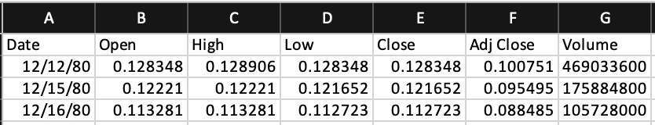
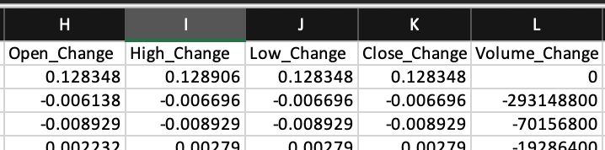
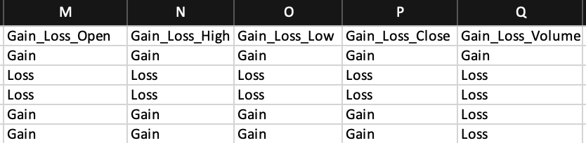
Database Integration: Data Pre-Processing
The Data Pre-Processing was based on figuring what story we were trying to tell.
Base dataset had the following features:
Date, Open, High, Low, Close, Adj Close, and Volume
The following features were later added via formulas and through a SQL join:
Season, Quarter, a 24hr change column for each price variable, and a Gain_Loss column based on its relative 24hr change column

Slide 8
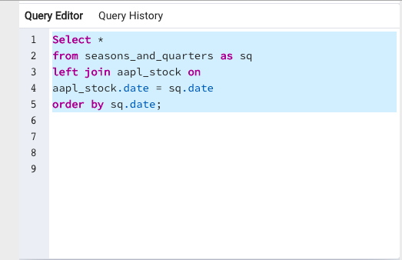
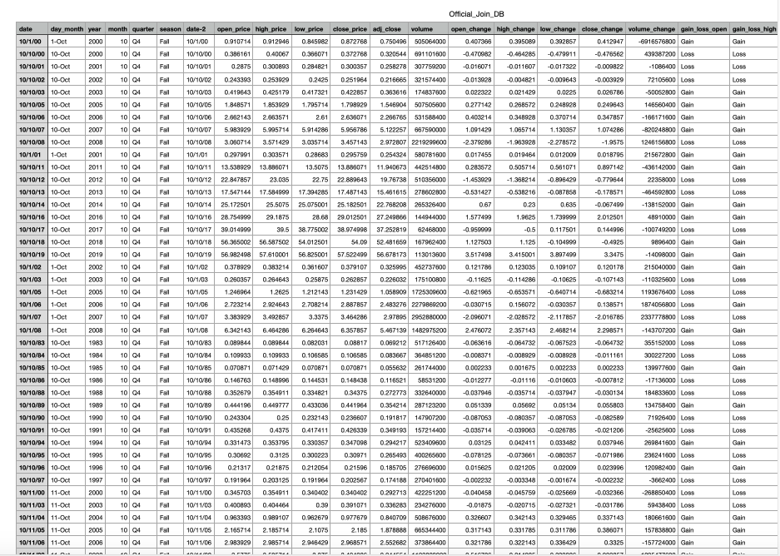
Database Integration: SQL
The database was joined by using the query below using the Kaggle dataset and season and quarter dataset.

Slide 9
Machine Learning Introduction
Preliminary
data pre-processing
feature engineering
feature selection
How the data is split into training and testing sets
Model choice, its’ limitations, and its’ benefits

Slide 10
Preliminary Feature Engineering & Feature Selection
Pre-Processing & Preliminary Feature Engineering
Features: Date, Season, Quarters, Price Variables, Volume, “<Price_Variable> _24hr_ Change”
Target: “Gain_Loss_<Price_Variable>” column (Open, Close, High, Low)
The “<Price_Variable>_24hr_Change” column
(current price - previous day’s price)
Calculated in chronological order by “Date”
The Gain_Loss column is based on the “<Price_Variable>_24hr_Change” column
“< 0 = ‘Loss’”
“>= 0 = ‘Gain’”
Preliminary Feature Selection
Based on Machine Learning studies, the target is based on two options only.
Examples:
0 or a 1
Yes or No
Approve or Deny
Gain or Loss
The Gain/Loss chosen as a target because gaining or losing on investments is what is important to the users of this model

Slide 11
Accuracy
Logistic Regression
Random Forest Model
Price Variables:
Low = 56%
Close = 54%
High = 55%
Open = 54%
Volume Variables:
With Volume 24hr Change Column
58%
With All Price Variable 24hr Change Columns as features with Volume Change as target
58%
Price Variables:
Low = 61%
Close = 63%
High = 60%
Open = 58%
Volume Variables:
With Volume 24hr Change Column
66%
With All Price Variable 24hr Change Columns as features with Volume Change as target
72%

Slide 12
Model Choice, Model Limitations & Benefits
Both Logistic Regression and Random Forest Model were great choices because everything is measured through time and time runs linear, ultimately:
Limitations: for time, the date format was not enough for the model to read. We had to convert dates to the “toordinal” time format which turns out to be the machine’s most preferred language
Benefits: not only is it a regression that works well in time, but it is beneficial in weighing the importance of each feature, and ultimately this weight answers our questions.
Choice: Random Forest Model.

Slide 13
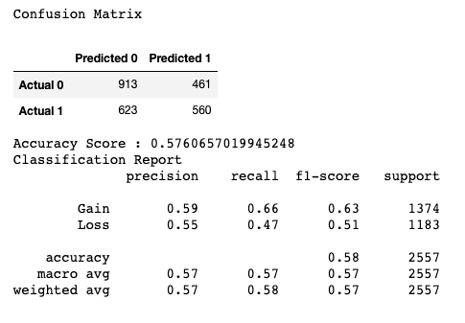
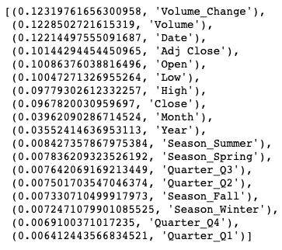
RFM Confusion Matrix and Feature Importance: Open

Slide 14
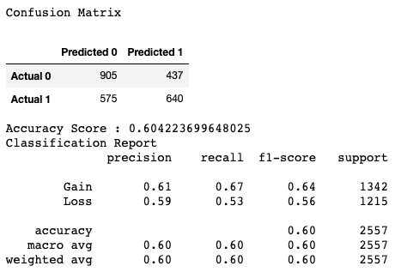
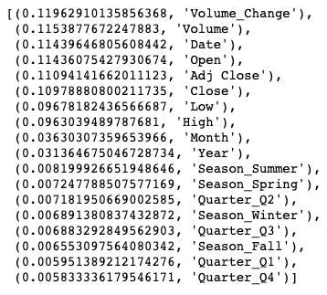
RFM Confusion Matrix and Feature Importance: Close

Slide 15
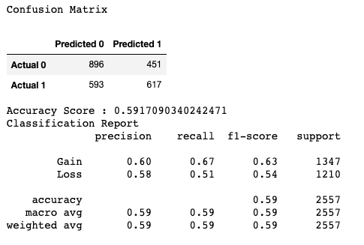
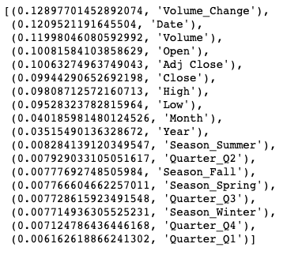
RFM Confusion Matrix and Feature Importance: High

Slide 16
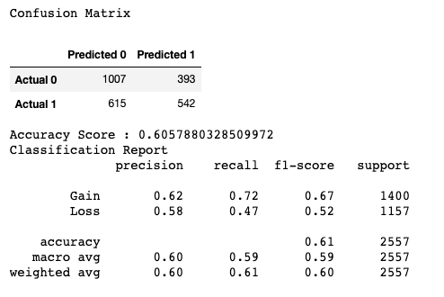
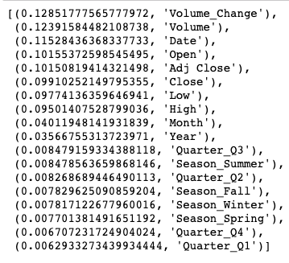
RFM Confusion Matrix and Feature Importance: Low

Slide 17
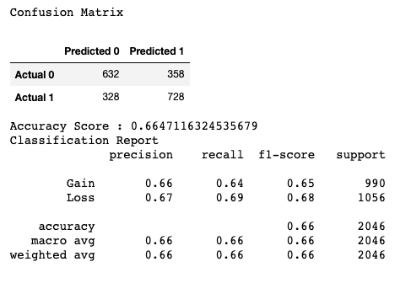
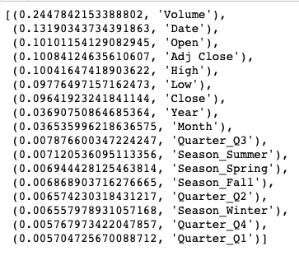
RFM Confusion Matrix and Feature Importance: Volume
Volume
Volume

Slide 18

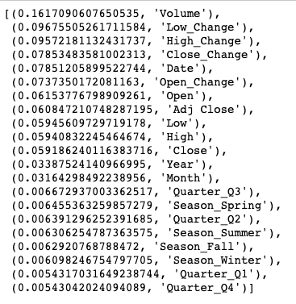
RPM Confusion Matrix and Feature Importance: Volume as Target with all 24hr Price Change Variables as Features
Volume with all 24hr Price
Volume with all 24hr Price Variable

Slide 19
Volume was significant to accuracy of Gain/Loss predictions
When combined with volume, the “Open” price variable weighed the most of all price variables
Opportunity for gains were most significant:
Spring ranked highest in importance, with summer tightly following
Spring: Mar 1 – May 31
Summer: June 1 – Aug 31
The 3rd Fiscal Quarter ranked as the highest quarter
July 1 – Sept 30
Moments of the greatest losses occurred:
In the winter season
Dec 1 – Feb 28
Tie between the 1st and 4th Fiscal Quarter
1st Q: Jan 1 – Mar 31
4th Q: Oct 1 – Dec 31
Observations Made in Machine Learning:

Slide 20
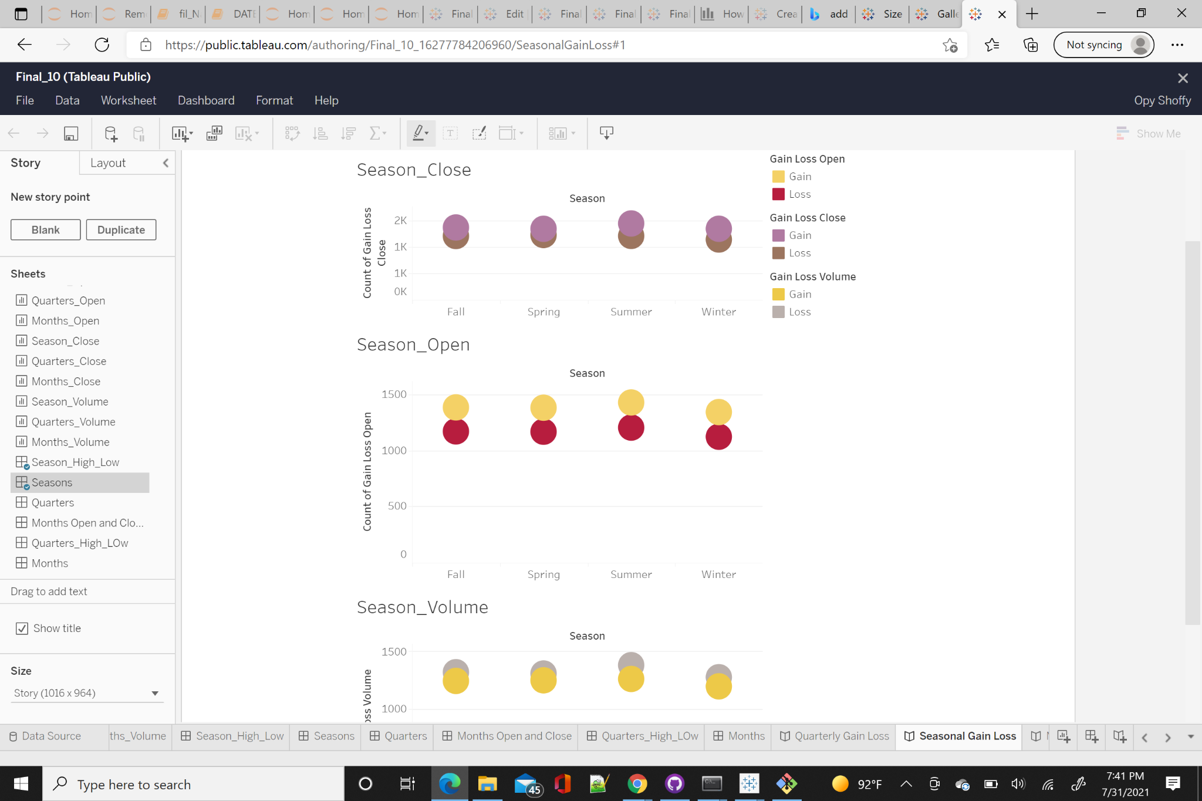
Dashboard
The dashboard contains worksheets, dashboard and stories that explains the connection between Seasonal, Quarterly and Monthly Gain/Loss. Attached is the link to the dashboard:
https://public.tableau.com/app/profile/opy.shoffy/viz/Final_Project_10_16277782240420/QuarterlyGainLoss

Slide 21
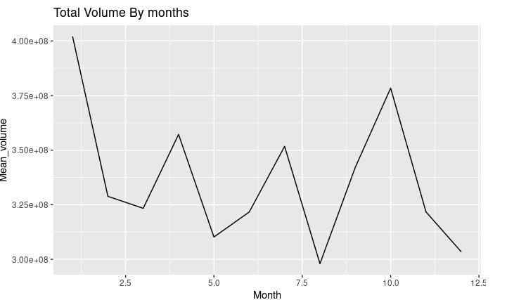
R-Analysis
Total Volume by months

Slide 22
Volume was significant to accuracy of Gain/Loss predictions
When combined with volume, price variables had a higher accuracy than without volume consideration, and the “Open” price variable weighed the most in importance of all price variables
Opportunity for gains were most significant:
In the summer
During the 3rd Fiscal Quarter and 2nd Fiscal Quarter
Moments of the greatest losses occurred:
In the winter season
Tie between the 1st and 4th Fiscal Quarter
Conclusion of Analysis:
Website

